Slide 1
English
Unit 2 – Sport
WALT:
6Ug.12 Use an increasing range of modal forms.

Slide 2



WALT: Use an increasing range of modal forms.
I can use “should”, “must” and “need to” give advice or instructions.
I can use “shouldn’t”, “mustn’t” and “don’t need” to give advice or instructions.
I can give reasons for my advice or instructions.

Slide 3
Retrieval Practice –
On your whiteboards, write as many prepositions as you can.
You have 30 seconds.
WALT: Use an increasing range of modal forms.
.

Slide 4
Starter – From the prepositions, which fits best?
WALT: Use an increasing range of modal forms. Give a sequence of instructions.
England is ______ to France.
The girl ran ________ the rain.
Vietnam is ____________ China.

Slide 5
TTYP – What is a modal verb?
WALT: Use an increasing range of modal forms. Give a sequence of instructions.
Modal verbs are verbs that indicate likelihood, ability, permission or obligation.
can/could
may/might
will/would
shall/should
must

Slide 6
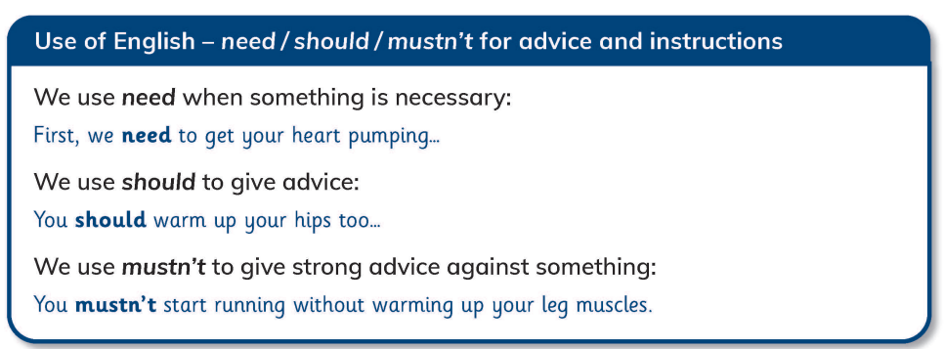
WALT: Use an increasing range of modal forms. Give a sequence of instructions.

Slide 7
Be careful when using mustn’t and don’t need.
WALT: Use an increasing range of modal forms. Give a sequence of instructions.
Mustn’t is used to say you are not allowed to do something.
Example: You mustn’t run in the corridor.
Don’t need is used when you don’t have to do something but you can if you want.
Example: You don’t need to bring post it notes to school.

Slide 8
Write some advice or instructions for your partner in your notebooks.
WALT: Use an increasing range of modal forms. Give a sequence of instructions.
Use should, must and need to give a sequence of advice or instructions.
Example: You need to brush your teeth twice a day.
Include shouldn’t, mustn’t and don’t need in your advice or instructions.
Example: You shouldn’t eat too much chocolate.
Give reasons for your advice or instructions.
Example: You should exercise every day to make your body fit and strong..

Slide 9
WALT: Use an increasing range of modal forms. Give a sequence of instructions.
I can use “should”, “must” and “need to” give advice or instructions.
I can use “shouldn’t”, “mustn’t” and “don’t need” to give advice or instructions.
I can give reasons for my advice or instructions.

Slide 10
Plenary
WALT: Use an increasing range of modal forms. Give a sequence of instructions.
Share your sentences with your partner.
Can you spot their modal verbs?

